Slide 1
Estimation of Percentage of Bodyfat
Group2
David Gao
Marwan Lloyd
Shuwei Liu

Slide 2
Contents
Data Cleaning
Model Selection
Final Model and Description
Model Diagnostics
Strengths and Weaknesses

Slide 3
Data Cleaning
Deleted:
ID | BodyFat | Density
182 | 0 | 1.10
172 | 1.9 | 1.09
(Failed to recorrect it with density)
Changed the unit: Height (inches) to Height (cm)
Weight (lbs) to Weight (kgs)
Recorrect height<100cm with Adioposity:
ID | Height (cm) | Recorrected Height (cm)
42 | 74.93 | 176.53
Deleted DENSITY
Final cleaned data: n=250 (from n=252) with p=14 predictors

Slide 4
Model Selection
Accuracy: Adjusted R-squared
Interpretability
Simplicity
Method | Model | Adjusted R-squared
PCA+Stepwise | BODYFAT~ PC1 + PC2 + PC3 + PC5 + PC6 + PC8 | 0.7190
Stepwise | BODYFAT ~ AGE + WEIGHT + NECK + ABDOMEN + THIGH + FOREARM + WRIST | 0.7312
SLR | BODYFAT ~ AGE + WEIGHT + ABDOMEN | 0.7102
SLR | BODYFAT ~ AGE + WEIGHT | 0.4434
SLR | BODYFAT ~ FOREARM + WRIST + ABDOMEN | 0.6926
SLR | BODYFAT ~ WEIGHT + ABDOMEN | 0.7111

Slide 5
Final Model
Weight (kgs)
Abdomen circumference (cm)
BodyFat% = -40.47 - 0.67 * Weight + 0.91 * Abdomen
 | Intercept | Weight | Abdomen
Estimation | -40.47 | -0.67 | 0.91
Standard Error | 2.42 | 0.09 | 0.05
P-value | < 2e-16*** | 4.84e-12*** | < 2e-16***
As men’s weight remain the same, when his abdomen circumference increases by one cm, he is expected to gain 0.91% in body fat.
As men’s abdomen remain the same, when his weight increases by one kg, he is expected to lose 0.67% in body fat.
Negative factor with weight: if people are gaining more weight without abdomen growth, they are probably gaining lean body tissue (such as, muscles) and thus the bodyfat% decreases.

Slide 6
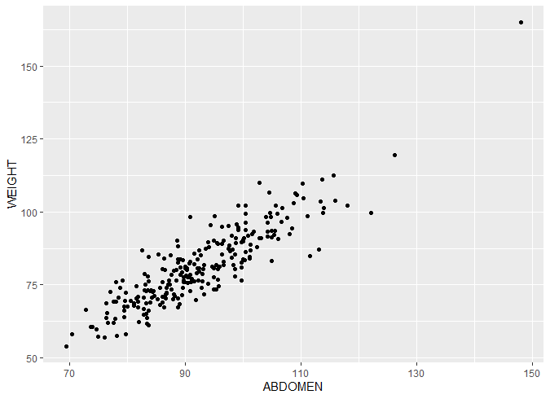
Correlation
1<VIF<5, which suggests that there is a moderate correlation, but it is not severe enough to warrant corrective measures
 | Weight | Abomen
VIF | 4.73 | 4.73

Slide 7
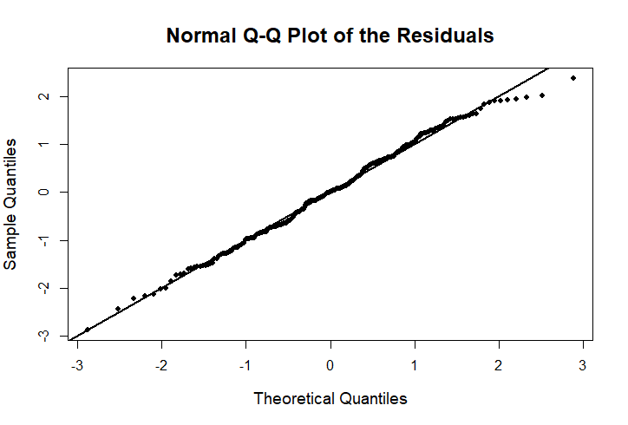
Model Diagnostics
Normality:
Reasonable: Hug the 45 degree line very closely
Slightly left skewed（2 to 3)
Slight skinny tail

Slide 8
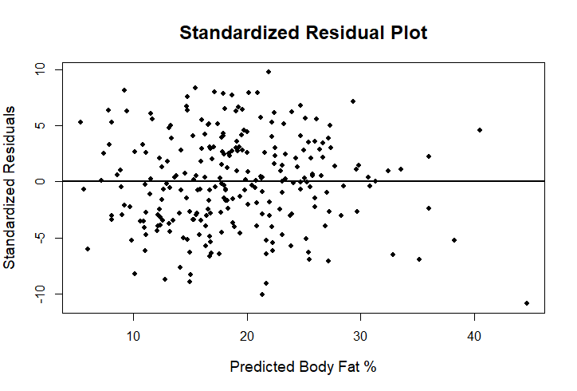
Model Diagnostics
Linearity:
Reasonable: No obvious non-linear trends
Homoskedasticity:
Plausible
Slight pattern for BodyFat%>30%

Slide 9
Strengths and Weaknesses
BodyFat% = -40.47 - 0.67 * Weight + 0.91 * Abdomen
Strengths:
Simple enough and will not lose much accuracy
Explains weight and abdomen circumference of variation in body fat
Weaknesses:
Require units

Slide 10
Thank you
Group2
David Gao
Marwan Lloyd
Shuwei Liu

